Slide 1
Bioinformatics screening regarding herbal components that targetedly regulate the function of tumour-associated macrophages
Ga-Young La
Molecular Cell and Developmental Biology Lab
Department of Biological Science
Konkuk University

Slide 2
Network Biology
Background Knowledge
Gene society라 할 수 있는 cellular system
동일한 유전자도 어떤 gene set과 상호작용 하는지에 의해 이질적인 기능을 나타낼 수 있음 -> pleiotropy
네트워크의 개발과 그 생물학적 응용에 집중하는 연구분야를 network biology

Slide 3
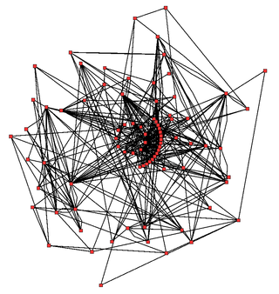
유전자 네트워크의 종류와 모델링 기법
Background Knowledge
system을 node와 edge로 모델링
node는 component, edge는 relationship
protein-protein interaction network
transcriptional regulatory network
functional gene network

Slide 4
functional gene network 생물학적 응용기법
Background Knowledge
gene의 새로운 기능 예측
gene의 기능상실이 개체 형질에 가져올 결과 예측
essential gene의 예측
disease causal gene과 그들의 modulator 예측

Slide 5
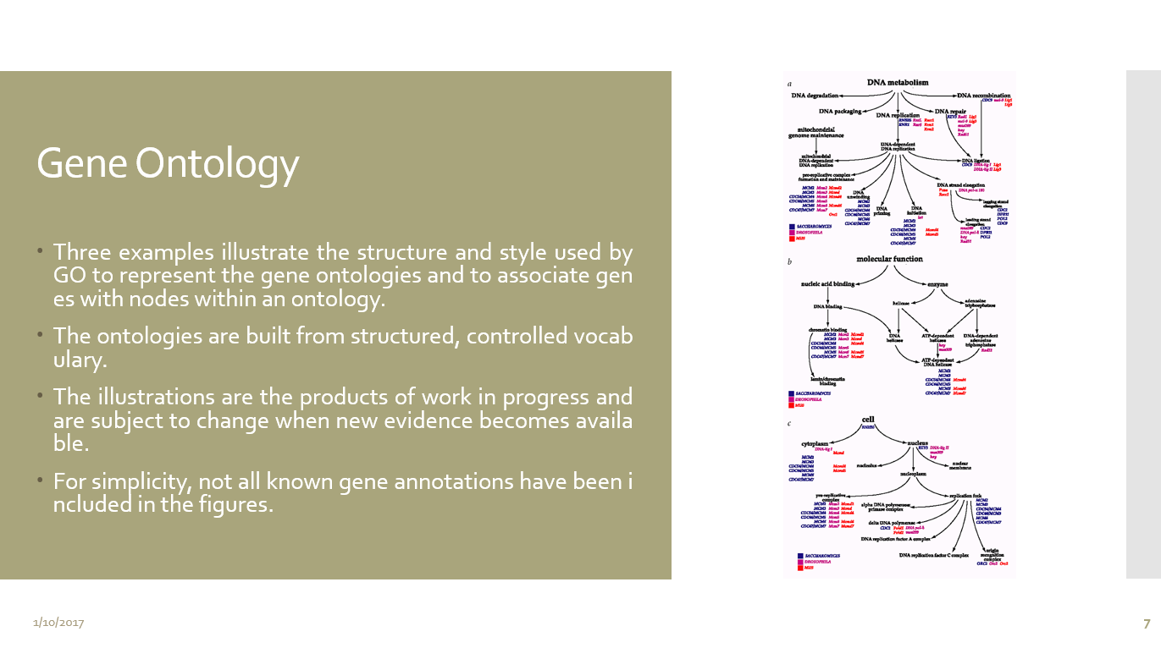
Background Knowledge
cellular component, molecular function, biological process

Slide 6
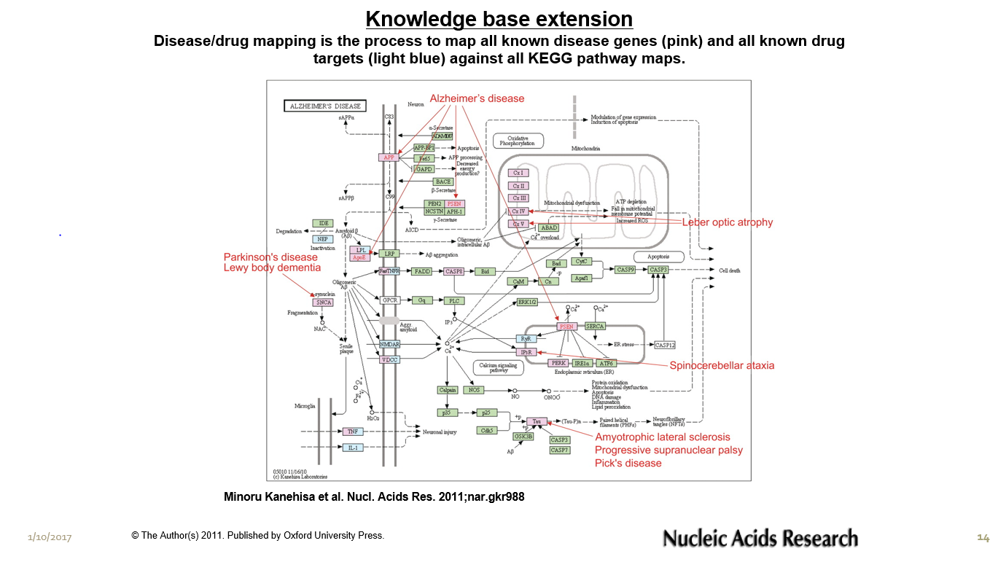

Slide 7
Introduction
Article
Tumour-associated macrophages(TAMs) are the most common type of inflammatory cells in tumour stroma.
Conventional cancer treatments include surgery, radiotherapy and chemotherapy, but the use of these treatments is greatly limited due to poor prognoses and severe side-effects.
Traditional Chinese medicinal herbs are being employed as new anticancer drugs.
In the present study, they used modular analysis bioinformatics techniques to screen for the differentially expressed genes in TAMs that play a role in their core functional groups.

Slide 8
Materials and methods
Article
Screening for differentially expressed genes in TAMs.
Establishing and analyzing the modules of the differentially expressed genes.
Screening for traditional Chinese medicine components that regulate the functional modules.
Literature review and the generation of a regulatory network connecting herbal components and modules.
Statistical analysis.

Slide 9
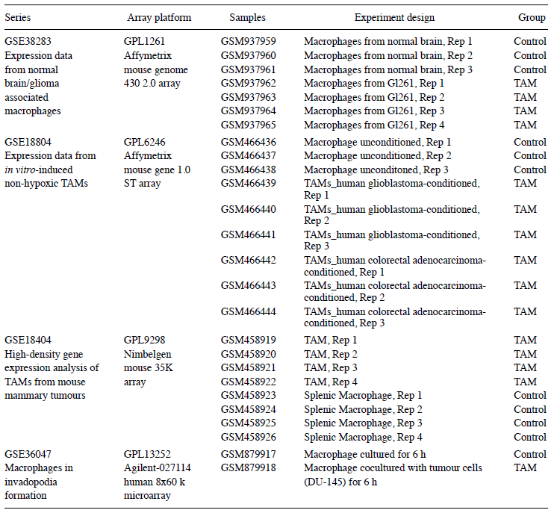
Summary of 4 data series
Article

Slide 10
Screening the gene modules.
Article
Among the 4 groups of TAM expression profiles, a total of 4,753 differentially expressed genes were identified.
PPI network - 2,407 edges and 1,501 nodes.

Slide 11
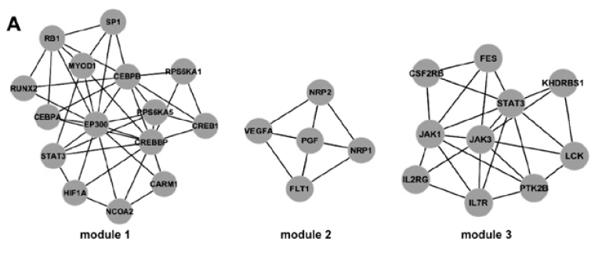
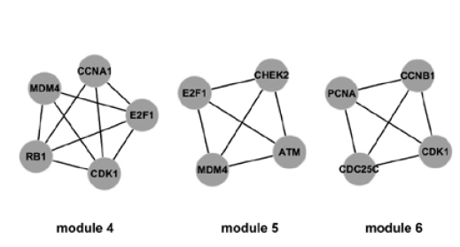
Screening the gene modules.
Article
CFinder software was used to identify modules within the sub-networks.
k = 4, 6 modules were identified that had a total of 46 genes.

Slide 12
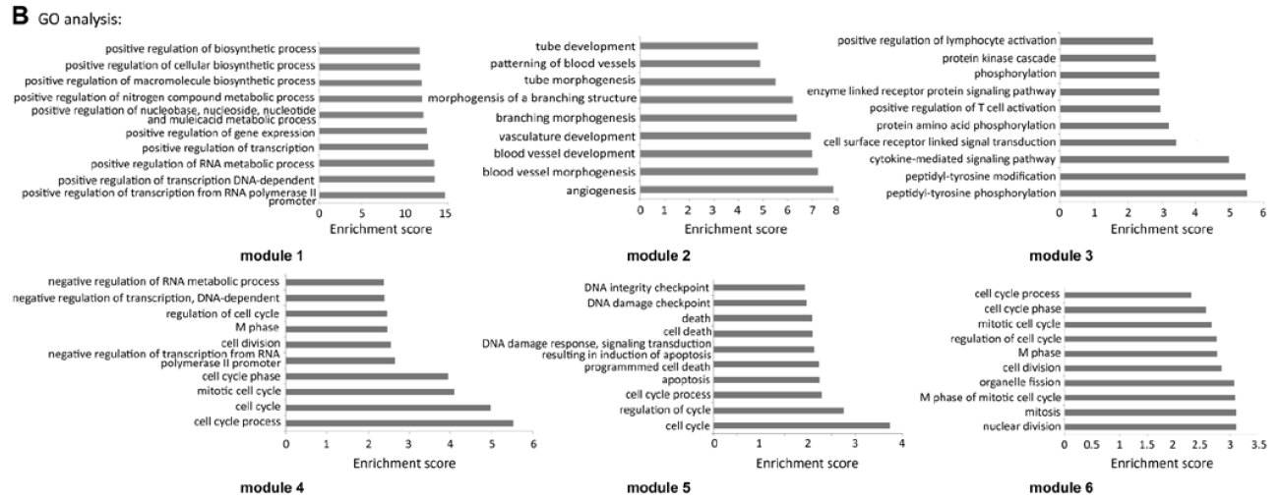
Functional analyses of the gene modules.
Article
DAVID software was used to conduct a GO_BP analysis of each module.
The top 10 scores were plotted as a bar chart.

Slide 13
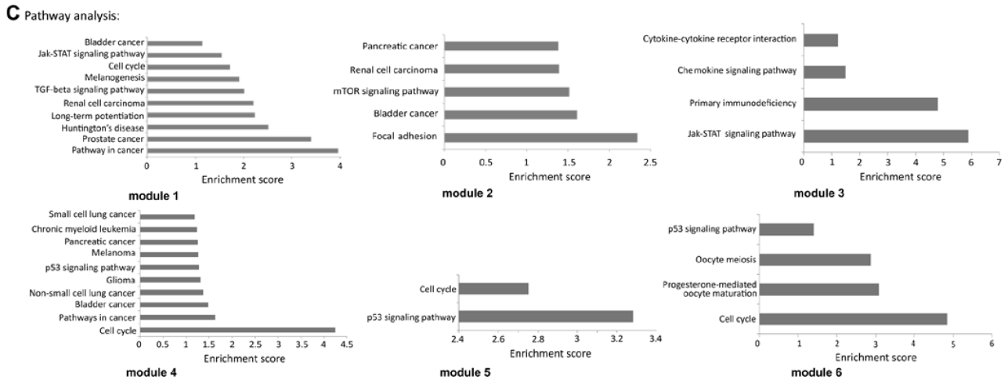
Functional analyses of the gene modules.
Article
DAVID software was also used to perform a pathway analysis of each module.
The top 10 scores were plotted as a bar chart.

Slide 14
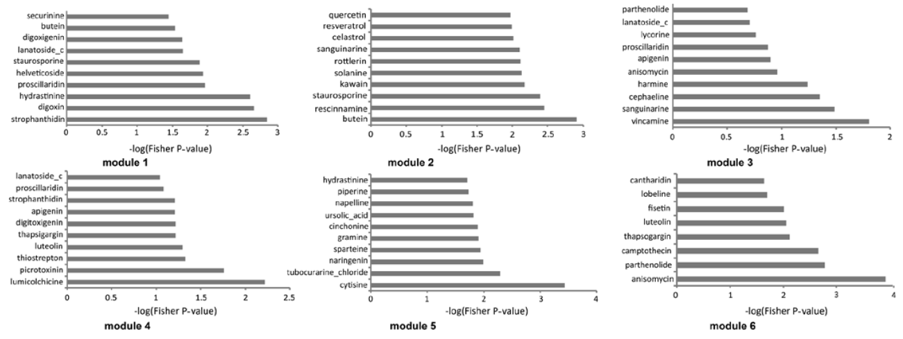
Herbal components that regulate the gene modules.
Article
The genes from each module were mapped with the differentially expressed genes found from the c-map database, allowing us to determine the relationships between the genes in each module and the tested small molecules.

Slide 15
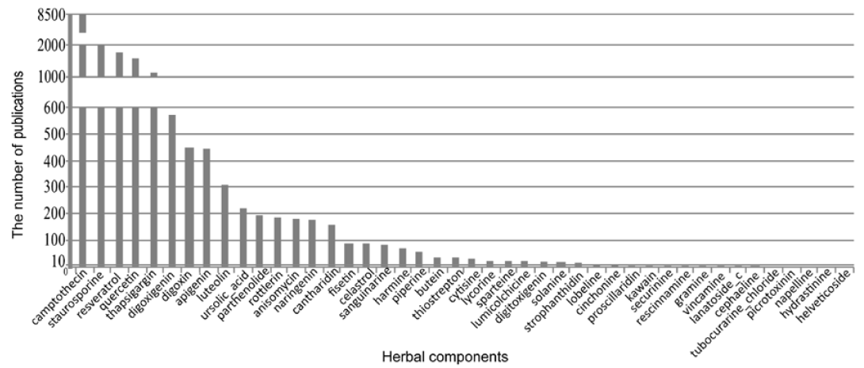
Potential new anticancer drugs.
Article
Potential new anticancer drugs that regulate the genes in the 6 core modules were identified through literature review.
the 44 determined herbal small molecules

Slide 16
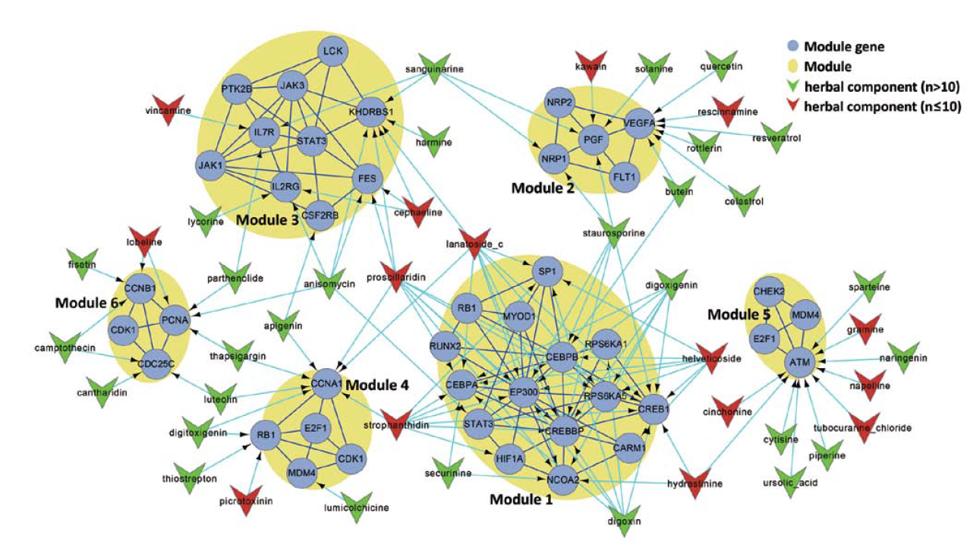
Creating a regulatory network connecting the herbal components and the modules.
Article
Combined with the 44 herbal components and the 6 modules and the results of the literature review.

